Slide 1
Monitoring Data Quality
with SAS Intelligent Decisioning

Slide 2
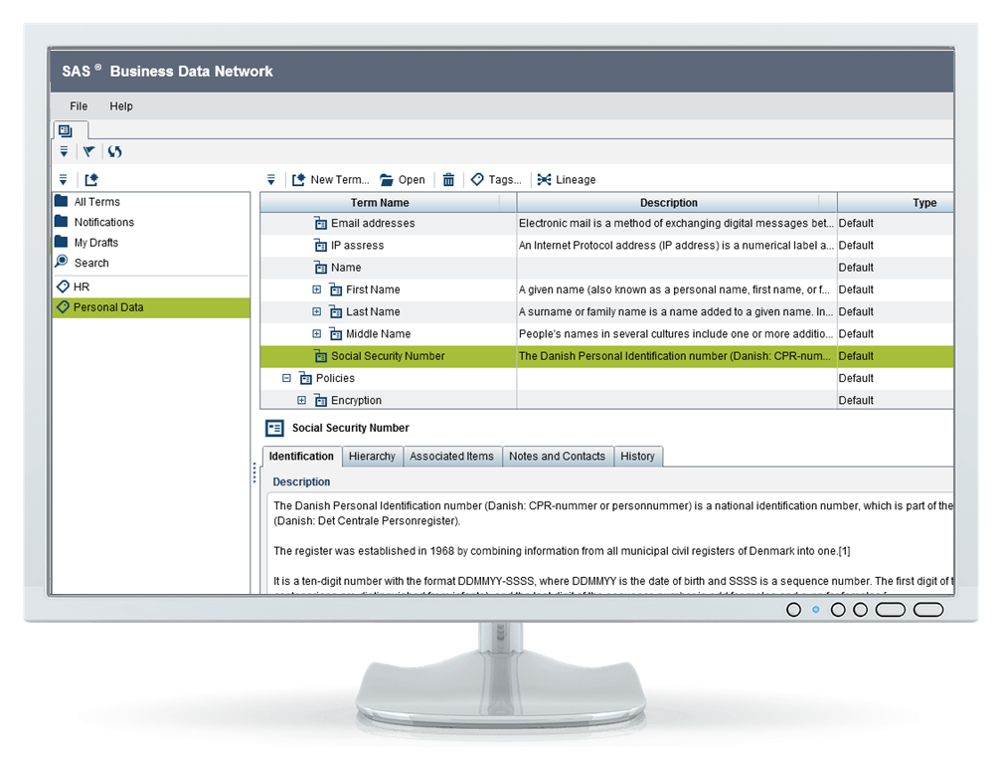
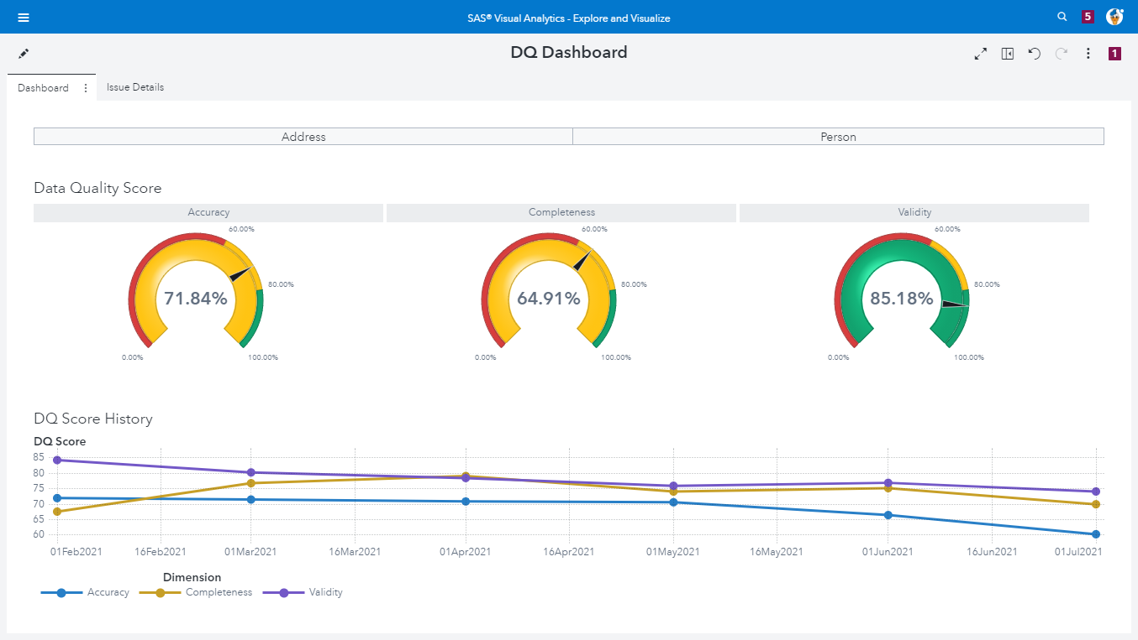
Monitor Data Quality
DQ Dashboards
Link strategy, business terms, data quality score and data improvement initiatives
Monitor data quality controls results through data stewardship console
Qualify data issues, severity and criticality
Investigate
Broadcast reference data & quality indicators across the organization
Pilot your improvement

Slide 3
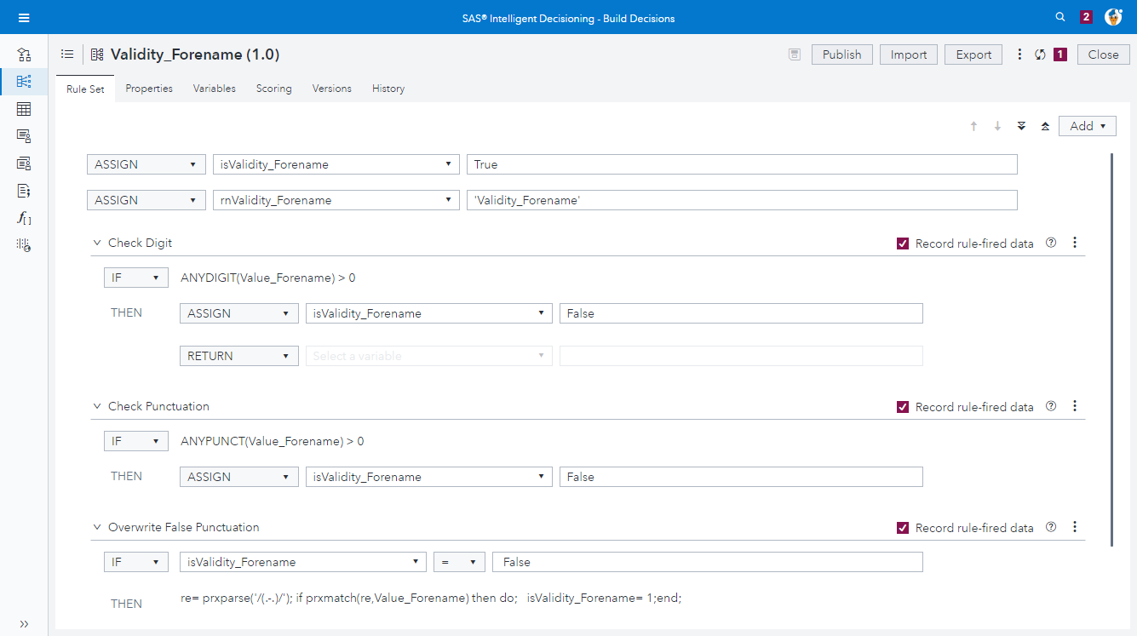
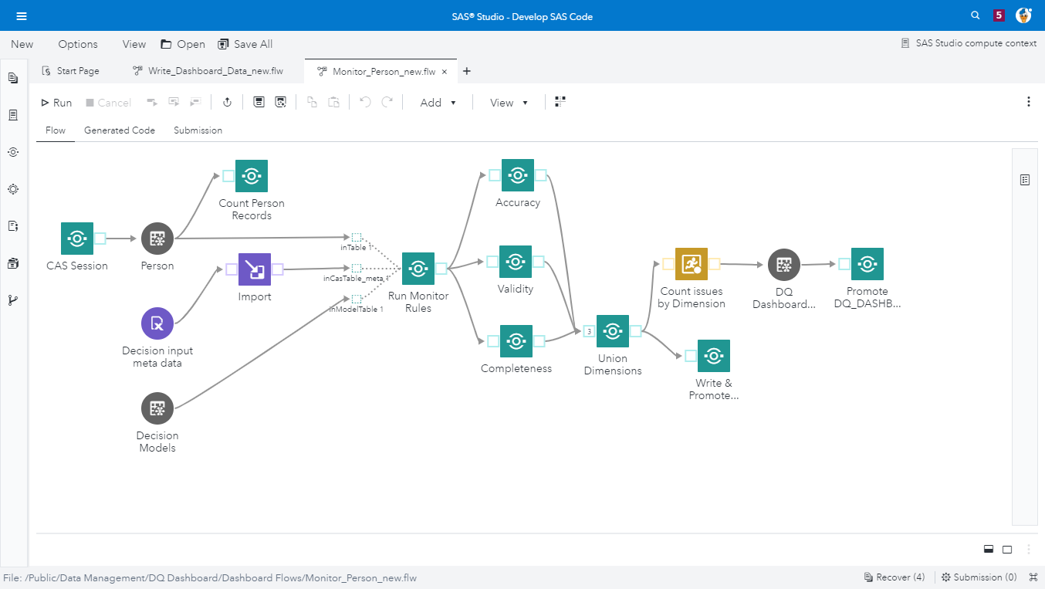
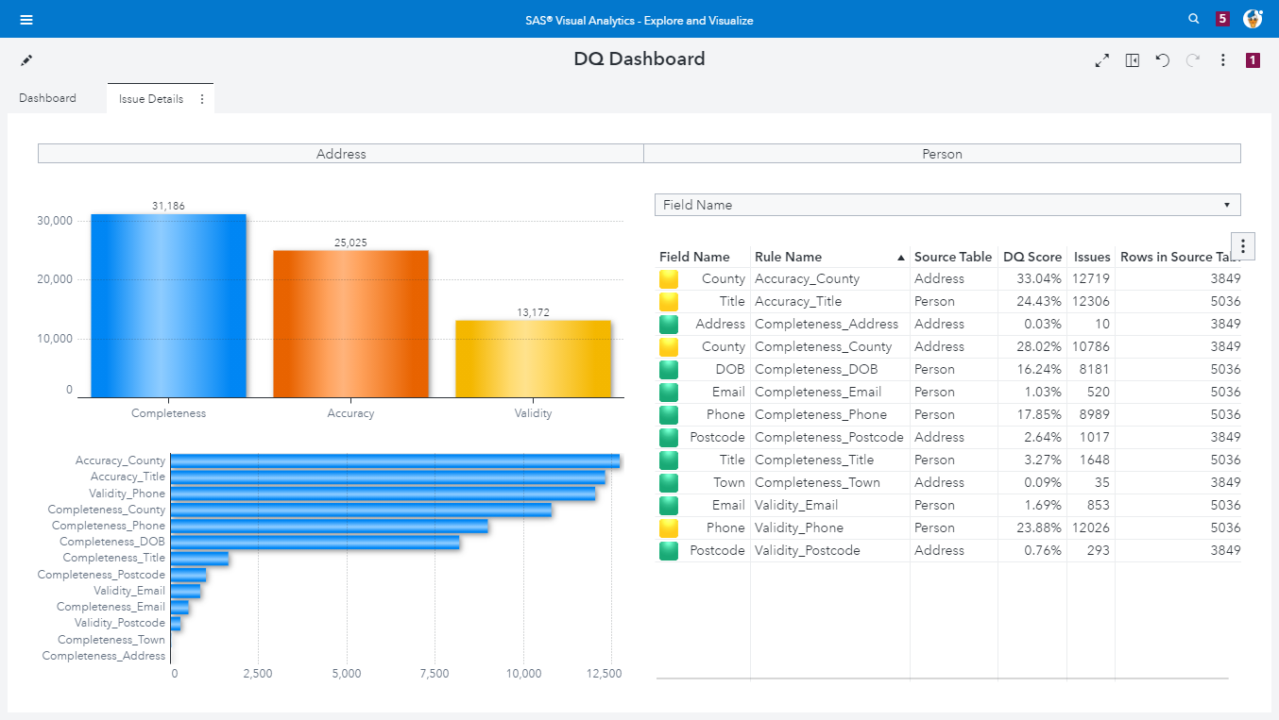
Monitor Data Quality
Intelligent Decisioning
Execute Quality Rules
SAS Studio
Build Quality Rules
Visual Analytics
Visual Analytics
Monitor Data Quality

Slide 4
Monitoring Data Quality in Viya
Data Quality Rules
Business Rules in Intelligent Decisioning
Monitoring field rules
Group dimensions together for each field
Monitoring task
Set all fields belonging to one monitoring source
Execute monitoring task
Using Studio Flows to execute Monitoring Task
Visualize monitoring result
DQ Dashboard in Visual Analytics

Slide 5
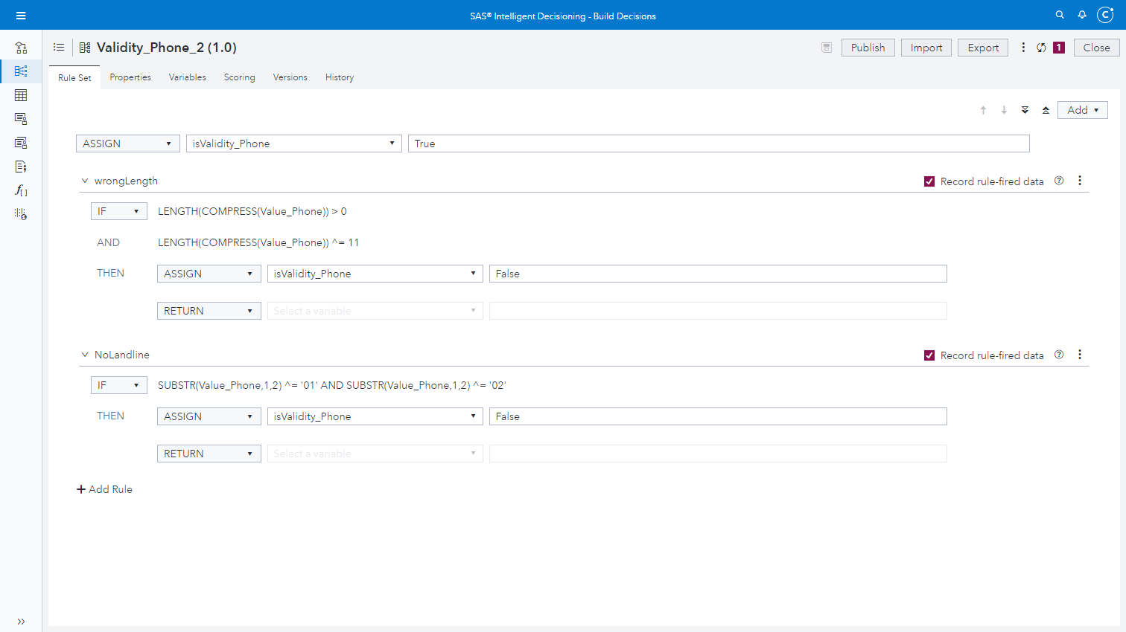
Notes:
In a business rule we pass in the value or values to check on and pass back the check result in a Boolean variable.
Here we see that we initialize the return variable.
We check if a UK land line phone number has the correct length
if not we set the return value to False otherwise we pass back True

Slide 6
Monitoring Data Quality in Viya
Data Quality Rules
Business Rules in Intelligent Decisioning
Monitoring field rules
Group dimensions together for each field
Monitoring task
Set all fields belonging to one monitoring source
Execute monitoring task
Using Studio Flows to execute Monitoring Task
Visualize monitoring result
DQ Dashboard in Visual Analytics

Slide 7
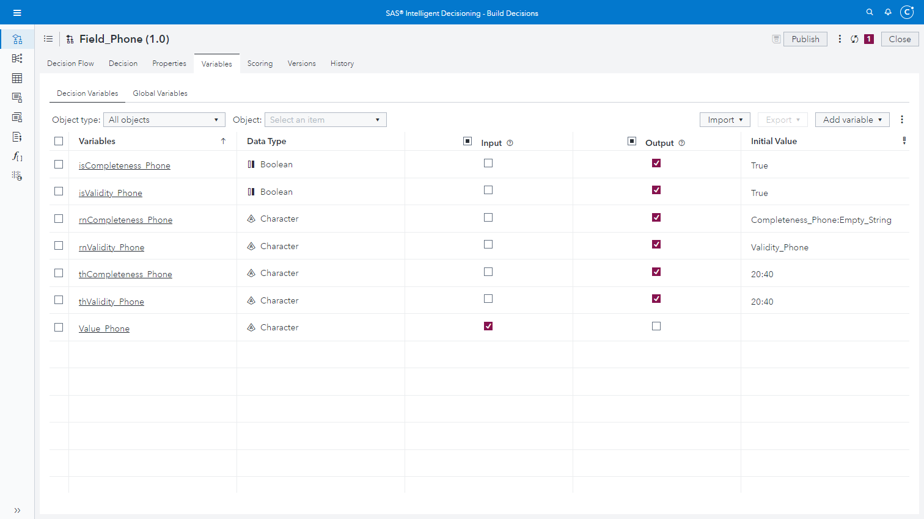
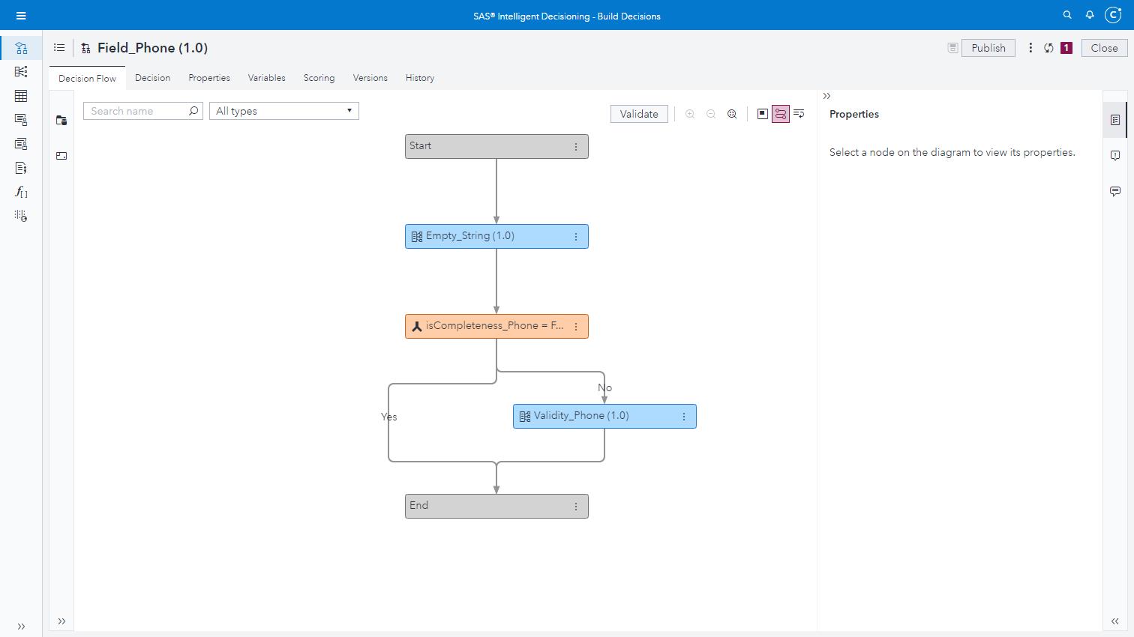
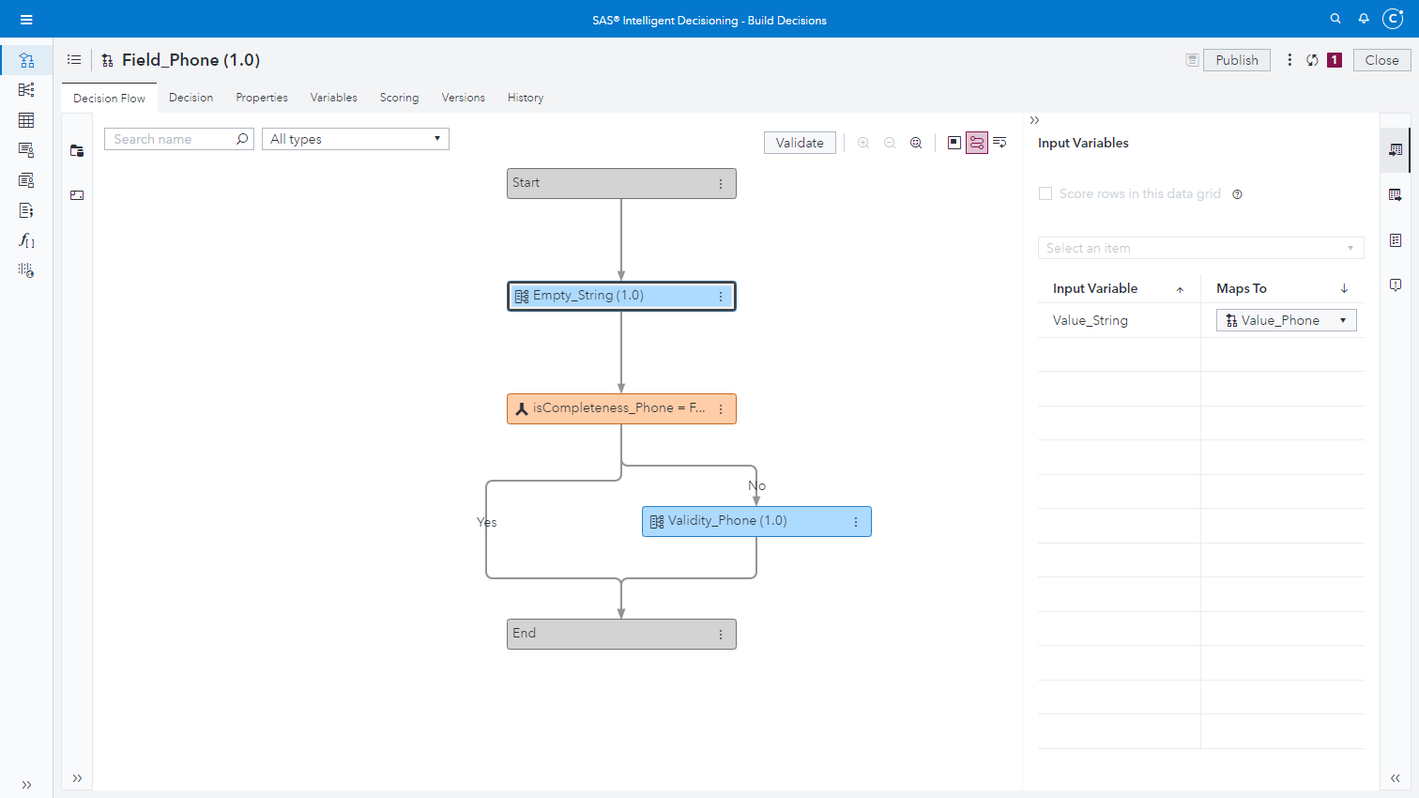
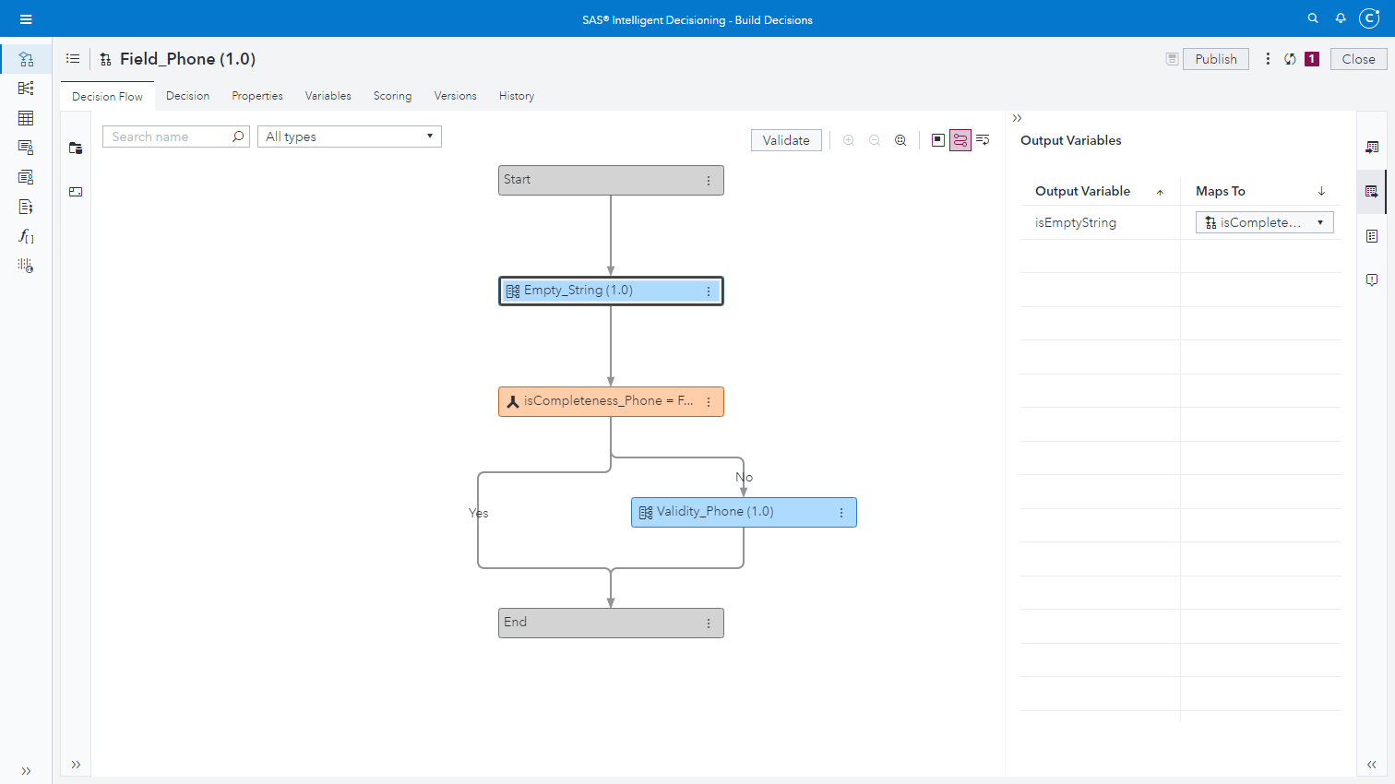
Notes:
In monitoring rules we group together all business rules that belong to one field.
Here we check for DQ dimension completeness. This is a generic rule that we can use for most character fields to check completeness.
We pass in the string value
And get Ture or False back as a result
Next we check if the completeness rule was triggered. In case it was triggered we don’t want to check for rules for this field
Otherwise we call the next rule. In this case a validity check
At the variables tab we can see that we pass in the variable to be checked
And we see that we have three variables per rule the we pass back:
isCompleteness_Phone: the indicator if the rule was true or false
rnCompleteness_Phone: a variable to DQ Dashboard, so we can see in the Dashboard what rules was fired.
thCompleteness_Phone: a variable, also for the DQ Dashboard, to control when a rule changes from green to yellow to red in the Dashboard

Slide 8
Monitoring Data Quality in Viya
Data Quality Rules
Business Rules in Intelligent Decisioning
Monitoring field rules
Group dimensions together for each field
Monitoring task
Set all fields belonging to one monitoring source
Execute monitoring task
Using Studio Flows to execute Monitoring Task
Visualize monitoring result
DQ Dashboard in Visual Analytics

Slide 9
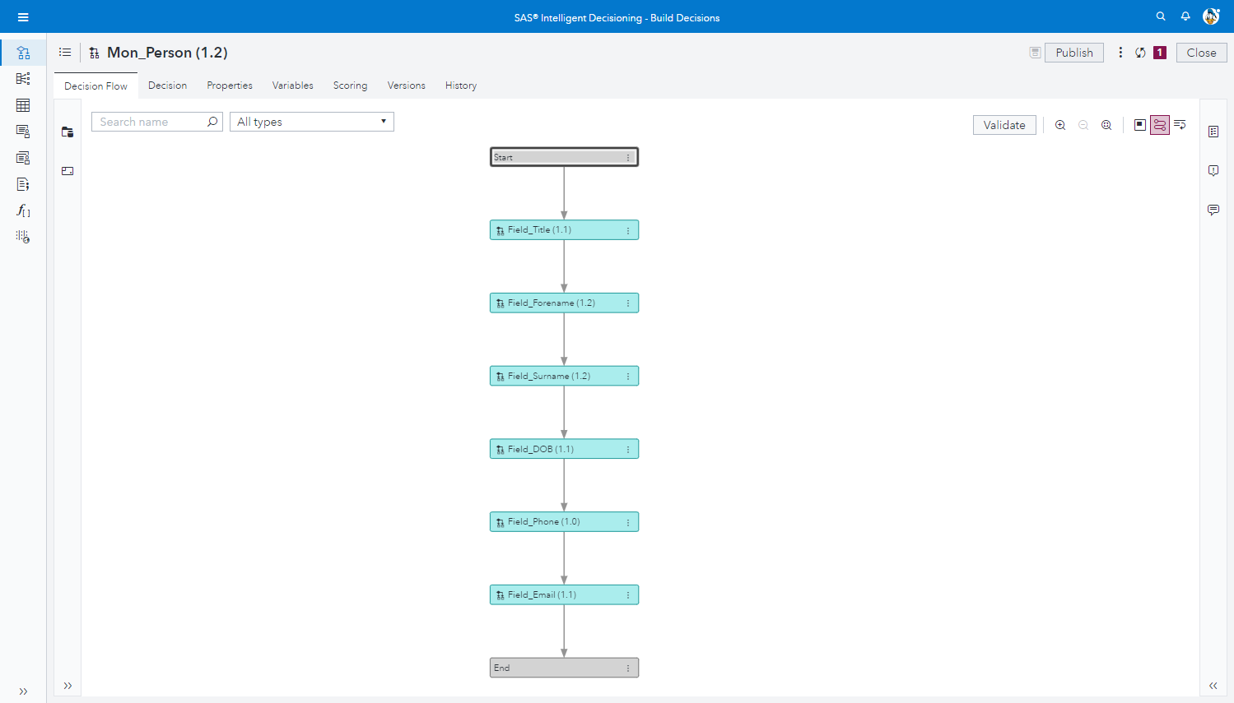
Notes:
The monitoring task is the decision flow that we are going to run when we monitor our data quality.
In this decision flow we group sequentially together all fields via the fields rules that belong to a data source (or at least all field in a data source that we want to check)

Slide 10
Monitoring Data Quality in Viya
Data Quality Rules
Business Rules in Intelligent Decisioning
Monitoring field rules
Group dimensions together for each field
Monitoring task
Set all fields belonging to one monitoring source
Execute monitoring task
Using Studio Flows to execute Monitoring Task
Visualize monitoring result
DQ Dashboard in Visual Analytics

Slide 11
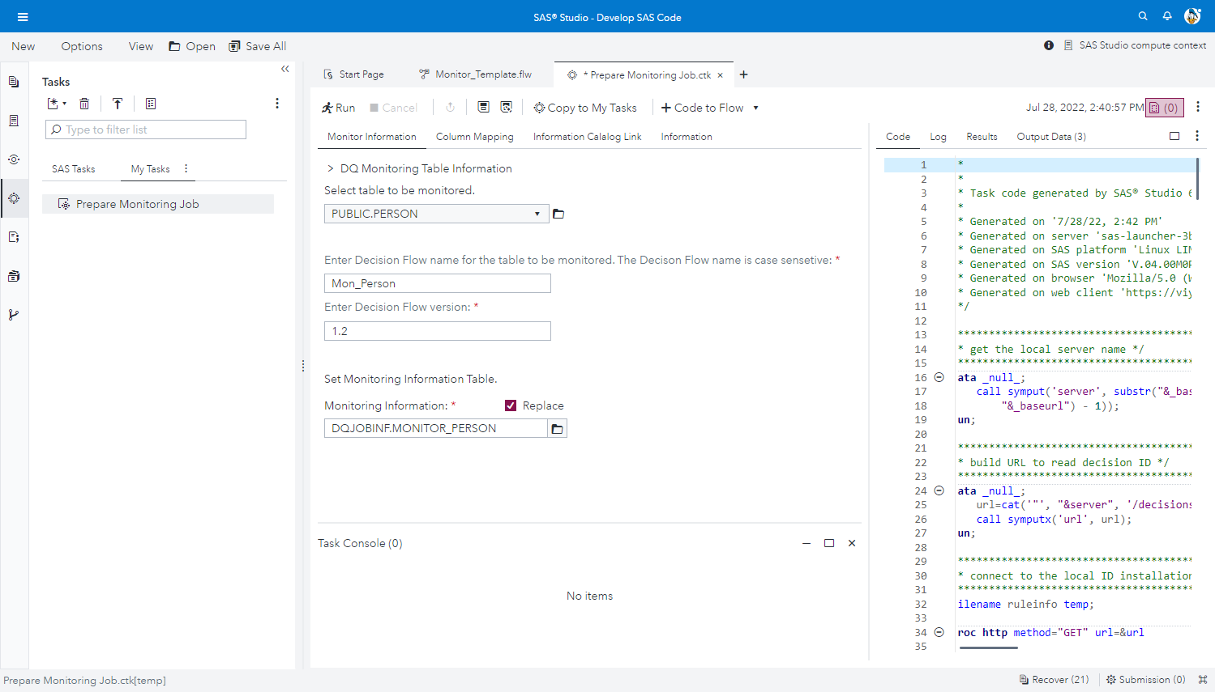
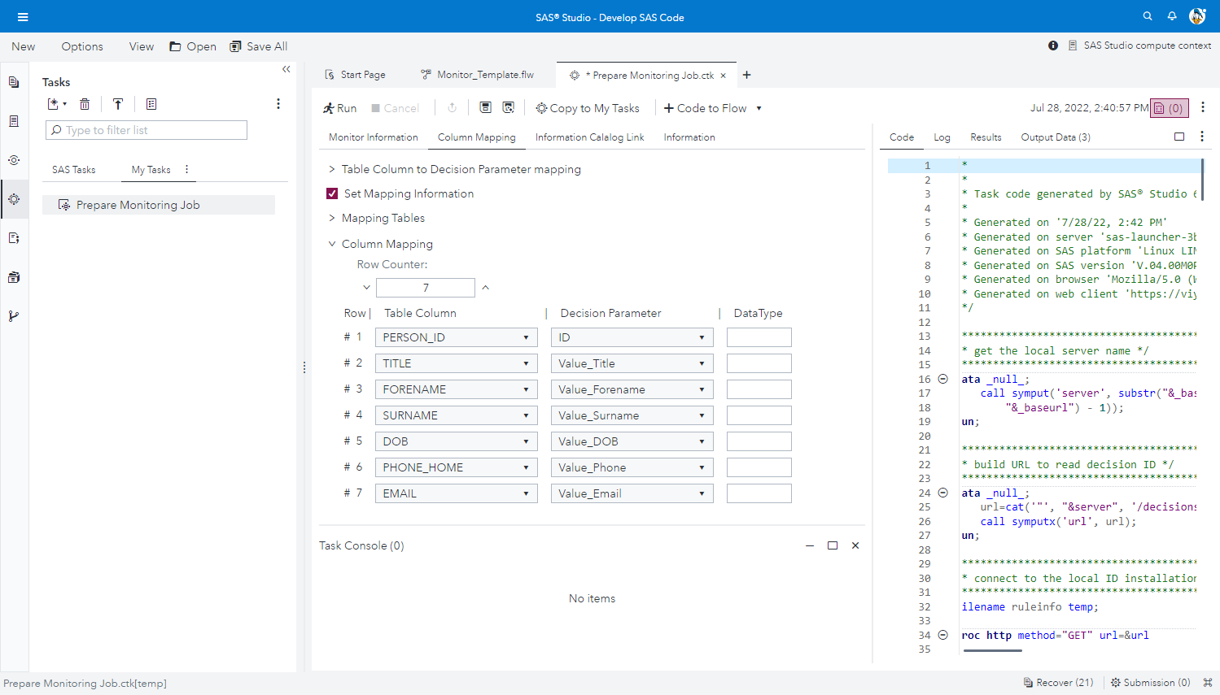
Notes:
From SAS Studio we run the monitoring task (decision flow)
We are using a Studio Flow (template) to run a monitoring task.
To configure the ETL job we use a Studio Task where we have a UI to fill in all necessary values.
We set
The data source to be monitored
The of the Decision Flow for the monitoring task and the version
And also the dataset where we store the configuration information
In the tab we also map the data source column names to the decision flow input parameters

Slide 12
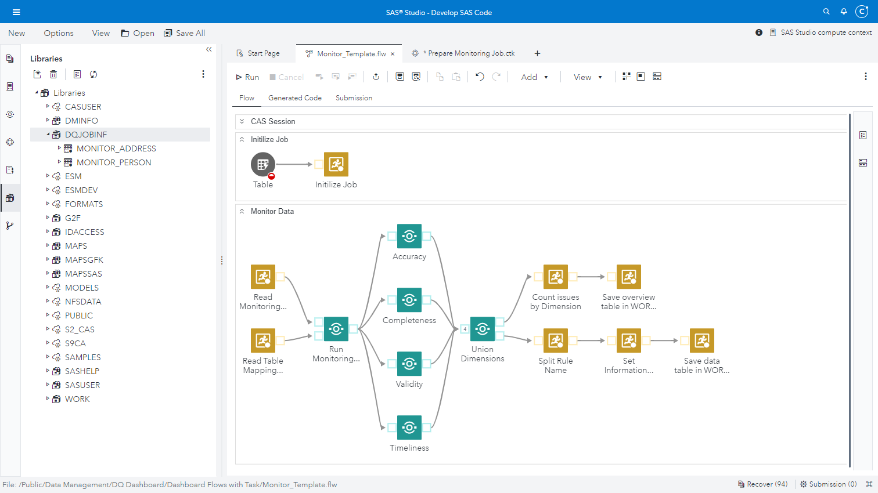
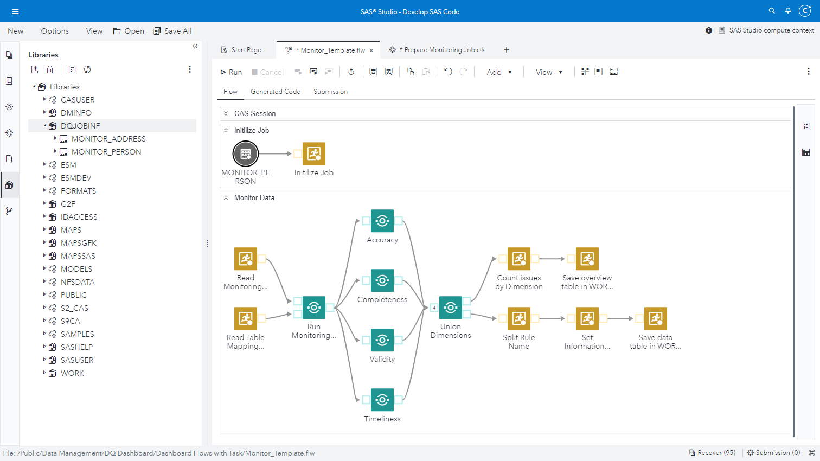

Notes:
When we have saved the configuration information to a dataset we link the dataset to the ETL template.
When we run the ETL job the data quality is checked and the output is prepared for being used in the DQ Dashboard

Slide 13
Monitoring Data Quality in Viya
Data Quality Rules
Business Rules in Intelligent Decisioning
Monitoring field rules
Group dimensions together for each field
Monitoring task
Set all fields belonging to one monitoring source
Execute monitoring task
Using Studio Flows to execute Monitoring Task
Visualize monitoring result
DQ Dashboard in Visual Analytics

Slide 14
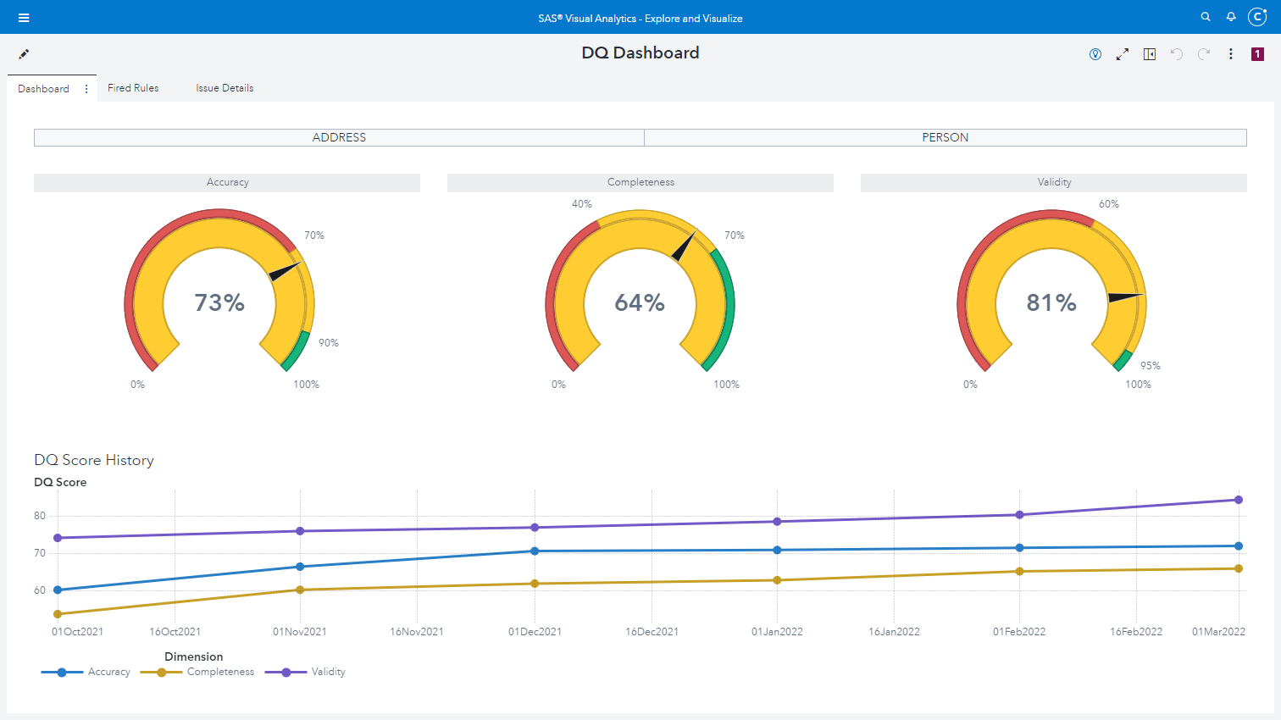
Notes:
Finally in the DQ Dashboard we visualize the result of the DQ monitoring

Slide 15
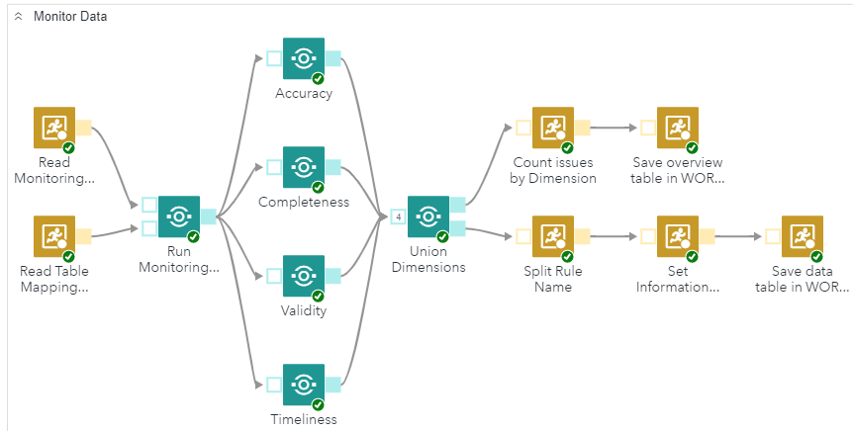
Recap
Business Rules
Field Rules
Field Name
Completeness Name
Field Name
Completeness Name
Validity Name
Field Phone
Monitor Data
DQ Dashboard
Validity Name
Field Phone
Completeness Phone
Completeness Phone
Monitoring Task
Accuracy Phone
Accuracy Phone
Monitor Person
Validity Phone
Validity Phone
Notes:
To recap the process:
Business Rules: We create generic and individual business rules for different DQ dimensions
Field Rules: We group all rules together that we want to run on a particular field
Monitoring Task: In a monitoring Task we put together all field of the data source that we want to check.
In SAS Studio we then execute the Monitoring Task via SAS Studio Flow…
…and visualize the result of the data quality monitoring in a Data Quality Dashboard in SAS VA

Slide 16
Demo

